Slide 1

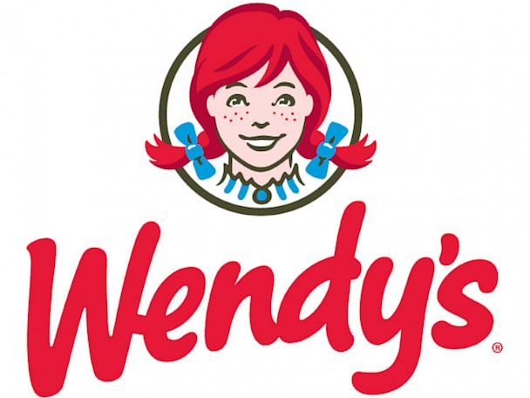
Marketing Analysis
Gordon Alfred, Paul Bramwell, Martha Carrion
Elizabeth Gibson, Joseph Hoy, Pranab Kumar Singh
Marketing Management Fall 2018
Professor Shen Yeniyurt

Slide 2
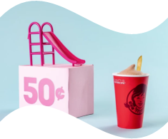
Executive Overview
About Wendy’s
Marketing Environment
Brand Positioning
Proposed Brand Revitalization Strategies

Slide 3
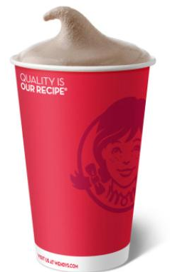
About Wendy’s
At-A-Glance
Quick-service hamburger restaurant
Founded in 1969
Operating in US, Canada, and abroad
Headquartered in Dublin, Ohio
6,500+ restaurants, ~90.0% based in the US
12,100 employees
2017 financials:
Revenue $1.223 billion
Operating margin 17.6%
Net margin 15.9%
Notes:
Revenue decline is primarily 2016 over 2017 driven because of poor performing corporate-owned restaurants
Revenue down from 14.8% from 2016
Operating margin down from 21.9% in 2016
Net margin up from 9% in 2016
For reference, McDonald’s had nearly $23 billion in revenue in 2017
McDonald’s operating margin was more than double Wendy’s in 2017
McDonald’s 2017 net margin 5% more than Wendy’s

Slide 4
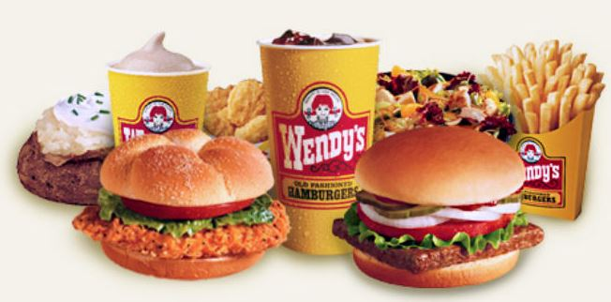
About Wendy’s
Products
Hamburgers, cheeseburgers
Chicken sandwiches
Chicken nuggets
Chili
Baked potatoes
Salads
French fries
Frostys
Kids meals
Notes:
Most famous products:
Frosty
Spicy chicken sandwich
Baconator

Slide 5
Marketing Environment
PEST Analysis
POLITICAL Trade wars and political unrest may negatively affect economy | ECONOMICAL US economy is healthy Consumer spending is up Globalization offers opportunities to breach new geographic markets
SOCIAL Continued focus on healthy eating Willingness to pay more for quality Trends in “fast casual” over “fast food” Busier lifestyles, heightened desire for convenience | TECHNOLOGICAL Online food ordering continues to trend In-restaurant technology for ordering expanding
Notes:
Fast Food is a $255 billion industry
Burgers make up over 30% of the industry
Industry revenue expected to grow over next five years
Fast casual examples - Chipotle, Sweetgreen, Dig Inn

Slide 6
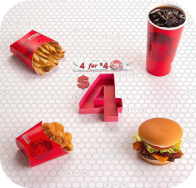
Marketing Environment
Fast Food Consumer Market
Involvement: Low to low-medium
Decision-making: Informed passive
Drivers: Brand perception, motivation, attitudes
Transaction: Repeated
Product classification: Closer to convenience
Notes:
In terms of their market, they operate in the fast food consumer market
Not buying a car but you do have an opinion on the brand ahead of time

Slide 7
Marketing Environment
SWOT Analysis
STRENGTHS Brand and market presence Menu offerings Focus on quality | OPPORTUNITIES Consumer desire for convenience and quality “Waaaay more than fast food.” Consumer spending New products
WEAKNESSES Liquidity Rising labor costs Over-reliance on limited time offers (LTOs) | THREATS Intense competition Low margin (competitive pricing) Rejection of junk food Meal prep companies Rising labor costs
Notes:
STRENGTHS: Market share / reach
McDonalds - 3.5%
Chipotle - 1.9%
Yum! Brands (KFC, Taco Bell, Pizza Hut) - 1.2%
Restaurant Brands International (PopEyes, Burger King) - .4%
Wendy’s - .3%
Reach: Third largest quick-service restaurant chain in the hamburger segment across the world
OPPORTUNITIES:
Recent product launches always offer an opportunity to attract new customers
Operational performance
Been losing money on company-owned restaurants in the past few years - currently trying to reduce the number of company-operated restaurants
WEAKNESSES:
The company reported decline in liquidity in FY2017, which could impact its growth and expansion plans.
The company reported 10.7% decline in current assets in 2017, compared to 1.3% decline in current
liabilities.
The company reported decline in its cost efficiency in FY2017. Its operating cost as a percentage of sales
stood at 82.4% in FY2017 compared to 78.1% in FY2016. This was due to decline in revenue by 14.8%
from US$1,435.4 million in FY2016, to US$1,223.4 million in FY2017. The decline in revenue was due to
fewer sales at Company-operated restaurants.
Opportunities: : Buffalo Ranch Crispy Sandwich; Berry Burst Chicken Salad

Slide 8
Brand Positioning
Current Segmentation
Marketing Mix:
Product: Fast food with a focus on quality
Price: Competitive, heavy use of price promotions
Promotion: Digital (Twitter), TV (commercials), outdoor, personal selling (in restaurant)
Place: Restaurants primarily
Competitive Strategy: Differentiation (“It’s waaaay better than fast food. It’s Wendy’s.”)
Core Competency: Fresh meat, never frozen
Customer Segmentation: Demographic and Behavioral
Millenials and Gen X
Busy lifestyles, health- and cost-conscious, family-orientation

Slide 9
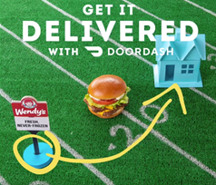
Brand Positioning
Current Distribution Strategies
Stand alone restaurants
Locations in malls and
shopping areas
Web site
Mobile app
Self-serve kiosks

Slide 10
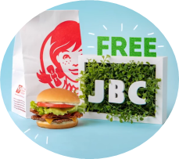
Brand Positioning
Current Positioning Strategies
From Wendy’s 2018 Q2 Financial Report:
“The Wendy’s Way: Delight Every Customer”
Be a “thriving & beloved restaurant brand”
“All things digital”
Download the Wendy’s app and get a free JBC!
Goal to have delivery available in 40% of North American restaurants in 2018
“Family orientation” with focus on quality “inside and out”
Fresh: “waaaay better than Fast Food”
Notes:
Find out if 40% of restaurants having delivery is competitive

Slide 11
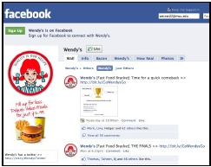
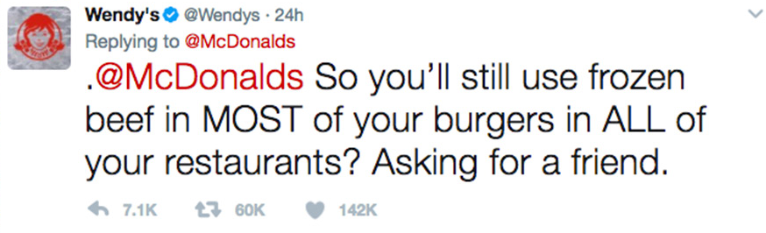
Brand Positioning
Current Communication Strategies
Very active social media presence has differentiated them from competition
- created a brand voice
Use Twitter to interact with customers and competitors - “earned media”
SEO and Google analytics
Notes:
Since its tweet exchange with a teenager last year ended up helping him score the most retweets ever and win him a year's worth of free Wendy's chicken nuggets, the chain has gained more than 970,000 new Twitter followers, it said. Fans have created many anime versions of Wendy's redheaded mascot on the internet, and many YouTube videos have been created just to highlightits tweets.
McDonald’s tried and failed - examples?
Pros/Cons

Slide 12
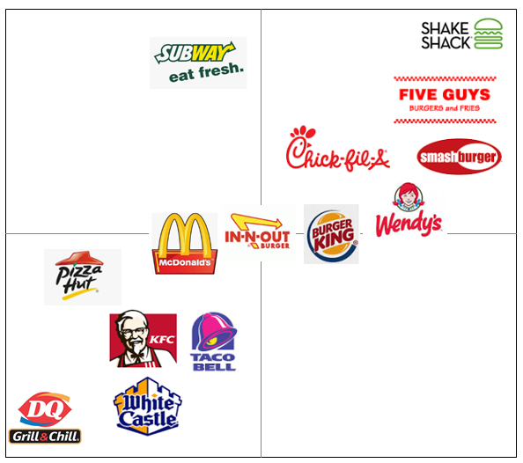
Positioning Map
Service - High-Quality
Unhealthy
Fresh
Service - Low-Quality
Notes:
Within the food services industry, consumers are anticipated to become increasingly health-conscious. Over the next five years to 2023, the healthy eating index is forecast to grow an annualized 0.6%. This slight change will have a big impact on the food services sector as more individuals will seek more health-conscious food options when eating at sector establishments. Traditionally, these healthier products have an added cost premium due to the more expensive ingredients and more careful preparation. This trend could provide increased profitability to sector operators that provide more health focused menu offerings. Conversely, operators that do not shift their product offering to cater to this new consumer trend may suffer from declining demand.
References: Hyland, Rachel; Pg. 11, IBIS World Sector Report 72 Accommodation and Food Services in the US June 2018

Slide 13
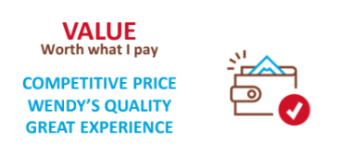
Brand Positioning
Current Pricing Strategy
Price differentiation = affordable quality
Pricing approach = competitive, balance between price and value
$0.99 - association with pocket change
Two-tiered pricing strategy
Sales promotions
Use limited time offerings (LTO) to promote “value”
$1 Double Stack
$0.50 Frosty to complement “4 for $4 everyday value”
Same store sales (SSS) have increased for 22 quarters straight
Notes:
They rank high among peers due to differentiation in quality, affordability and healthiness, differentiate by offering, top beef, they toast and butter buns and cook bacon in restaurants... they raised its food quality to compete with Chick-Fil-A...they should continue to work on their pricing strategy, know what competition is charging,
2 Tiered-pricing strategy - starts with discounted items that entice consumers in store once inside store pushes for other high margin items
they added limited time offer values strategies to appeal to budget conscious consumers, millennials look for value meals and they go more often because of the 4 for $4 value meal.
SSS are same-store sales is a business term which refers to the difference in revenue generated by a retail chain's existing outlets over a certain period (often a fiscal quarter or a particular shopping season), compared to an identical period in the, usually in the previous year

Slide 14
Proposed Brand
Revitilization Strategies
Improve ingredient quality
Shift brand perception to “fresh” and “fast casual”
Increase product price to offset cost of quality ingredients
Continue to bolster use of technology
Online ordering - customer convenience
In-store technology - help offset labor costs
Digital presence - continued digital communications strategy
Notes:
Boost efforts to improve ingredient quality – potentially move into gluten-free, non-GMO, organic, locally-sourced, etc.
Shift brand perception to more “fresh” and “fast casual” by promoting improved ingredients and plant-based meal options
Increase product price to take advantage of strong economy and customer willingness to pay more for quality to offset cost of using better ingredients
Continue to bolster technology in their restaurants and accelerate their partnership with Door Dash (or maybe Alexa or Google Home)
Utilize online ordering and in-store kiosks to offset labor costs

Slide 15
Questions?

Slide 16
Sources
Chapman, Mary, and Sara Rush. “7 Key Consumer Types.” Restaurant Business, vol. 115, no. 1, Jan. 2016, pp. 66–76. EBSCOhost, login.proxy.libraries.rutgers.edu/login?url=http://search.ebscohost.com/login.aspx?direct=true&db=b9h&AN=112187532&site=ehost-live
Cheng, A. “How Wendy's Learned To Stop Worrying And Love Its Twitter Roasts Of McDonald's.” Forbes. Forbes.com. 8 Oct 2018. https://www.forbes.com/sites/andriacheng/2018/10/08/wendys-twitter-roasts-have-become-the-envy-of-marketers-heres-how-it-does-it/#5662da95fea4. Accessed 3 Dec. 2018.
Hyland, Rachel, “IBISWorld Industry Report 72221a: Fast Food Restaurants in the US.” IBISWorld. October 2018. Web. 2 Dec 2018.
MacArthur, Kate. “Burger Titans Take Cue from Wal-Mart.” Advertising Age, vol. 73, no. 7, Feb. 2002, pp. 4–21. EBSCOhost, login.proxy.libraries.rutgers.edu/login?url=http://search.ebscohost.com/login.aspx?direct=true&db=buh&AN=6132446&site=ehost-live.
NewsWire. “McDonald's Ditches Frozen Beef in Bid to Boost Sales.” MarketLine, www.marketlineinfo.com, 2 Aug. 2018, advantage.marketline.com.proxy.libraries.rutgers.edu/Product?ptype=Company News&pid=4EB65624-435E-4160-874E-F9FC9ADCF17B.
Smithson, Nathaniel. “Wendy's Marketing Mix (4Ps) Analysis.” Institute, 7 Feb. 2017, panmore.com/wendys-marketing-mix-4ps-analysis.
Topper, Amanda. “Burger Trends - US - April 2018.” Mintel Group Ltd, Apr. 2018, academic.mintel.com.proxy.libraries.rutgers.edu/display/860379/#.
Wendy’s International, LLC. “Second Quarter 2018 Conference Call.” Wendy's Investor Relations, 8 Aug. 2018, www.wendys.com/sites/default/files/2018-08/2018 2Q CC vF_2-up for web.pdf.
“Wendy’s International, LLC.” Wendy’s International, LLC MarketLine Company Profile, Nov. 2017, pp. 1–14. EBSCOhost, login.proxy.libraries.rutgers.edu/login?url=http://search.ebscohost.com/login.aspx?direct=true&db=buh&AN=129823343&site=ehost-live
“The Wendy’s Company SWOT Analysis.” Wendy’s Company SWOT Analysis, July 2018, pp. 1–8. EBSCOhost, login.proxy.libraries.rutgers.edu/login?url=http://search.ebscohost.com/login.aspx?direct=true&db=buh&AN=131228274&site=ehost-live
Notes:
Social media articles

